Slide 1
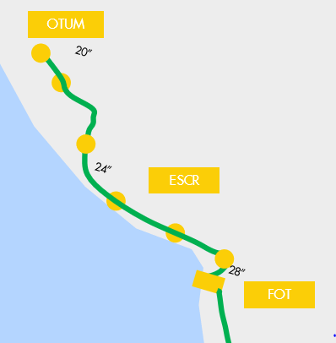
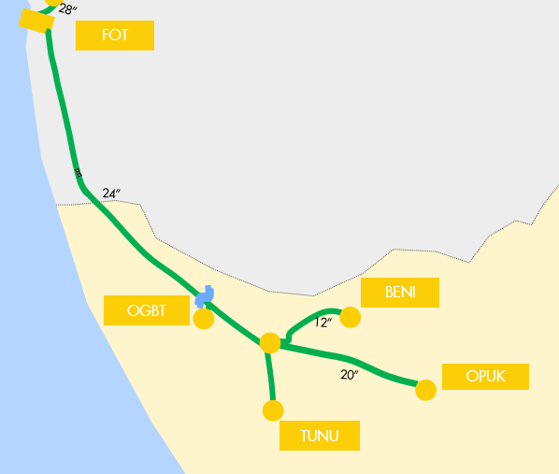
CONVOY MOVEMENT

Slide 2
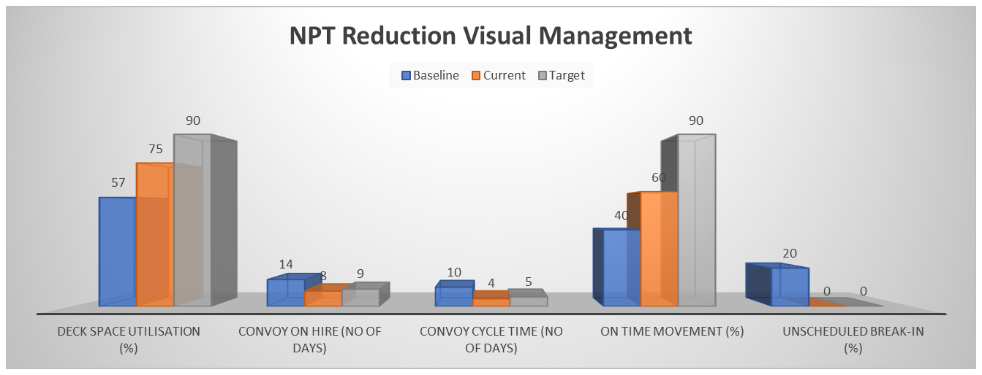
Pre and Post-Improvement Metrics
Operational Metric | Baseline | Current | Target
Deck Space Utilisation (%) | 57 | 75 | 90
Convoy Vessels on hire (No of days) | >14 | 8 | 9
Convoy Cycle Time (No. of days) | 10 | 4 | 5
On time Movement (%) | 40 | 60 | 90
Unscheduled Break-in (%) | 20 | 0 | 0

